Slide 1
Software characteristic
Important Characteristics are-
Software does not wear out.
Software is Flexible and Reliable.
Software is Engineered, Not Manufactured.
Reusability Of Components.

Slide 2
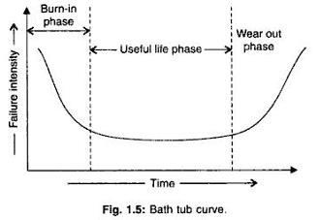
Software does not wear out

Slide 3
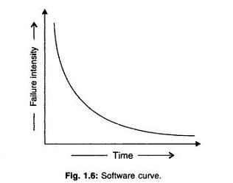
Software does not wear out

Slide 4
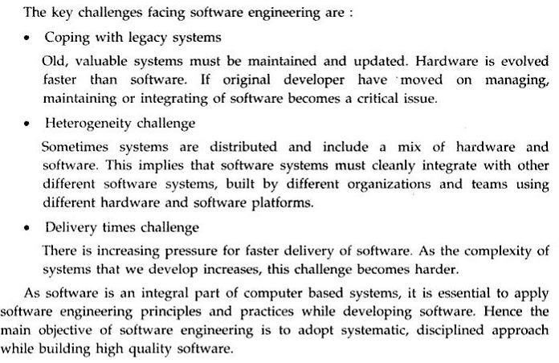
Challenges In Software Engg

Slide 5
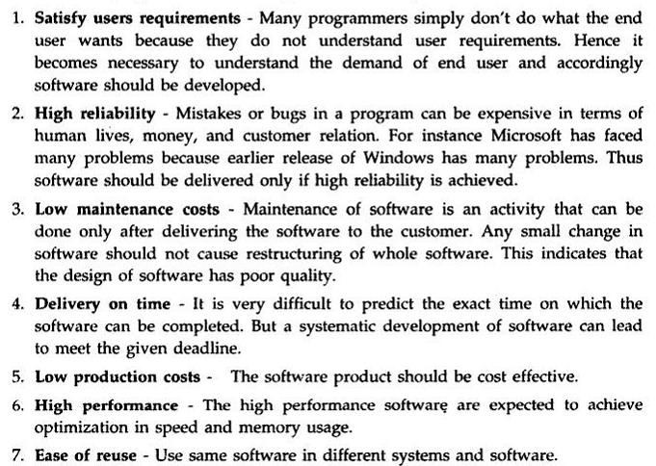
Goals Of Software Engg

Slide 6
Difference between Conventional and Software Engg
Issue | S/W Engg. | Conventional Engg.
Foundation | Based on CS, IS & Discrete maths. | Based on science,maths & emperical knowledge.
Cost | Project cost is higher than h/w. | Some projects material cost is high rather than manufacturing cost
Replication | Copy/paste, downloading, CD/DVD possible | Not possible, every time create new unit
Innovation | New and untested elements may be applied | Apply known and tested principles
Duration | Project lies for some years or decade | Projects endures for centuries e.g. bridges
Blame | Engineers blame themselves for problems | Engineers can blame to others
Age | SE is about 50 years old | CE is thousands of years old
Domain | Uses limited no. of concepts | Uses unlimited no. of concepts
Research | Research the unknown | Apply research result in known

Slide 7
Difference between Conventional and Software Engg.
1. Software Engineering Process: It is a engineering process which is mainly related to computers and programming and developing different kinds of applications through the use of information technology.
Software Engineering: Abstract Design ⎯⎯→ Abstract Code
2. Conventional Engineering Process : It is a engineering process which is highly based on empirical knowledge and is about building cars, machines and hardware.
Conventional Engineering: Abstract Design ⎯⎯→ Concrete Products

Slide 8
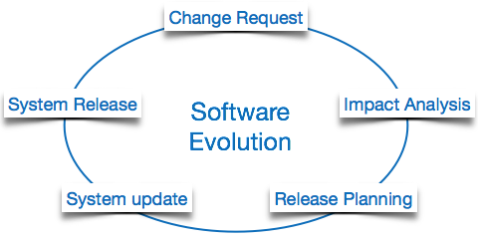
Software Evolution
The process of developing a software product using software engineering principles and methods is referred to as software evolution. This includes the initial development of software and its maintenance and updates, till desired software product is developed, which satisfies the expected requirements.

Slide 9
Software Paradigms
Software paradigms refer to the methods and steps, which are taken while designing the software. There are many methods proposed and are in work today, but we need to see where in the software engineering these paradigms stand. These can be combined into various categories, though each of them is contained in one another:
1. Software Development Paradigm: This Paradigm is known as software engineering paradigms where all the engineering concepts pertaining to the development of software are applied. It includes various researches and requirement gathering which helps the software product to build. It consists of –
Requirement gathering
Software design
Programming
2. Software Design Paradigm: This paradigm is a part of Software Development and includes –
Design
Maintenance
Programming
3. Programming Paradigm: This paradigm is related closely to programming aspect of software development. This includes –
Coding
Testing
Integration

Slide 10
Need of Software Engineering
Large software - It is easier to build a wall than to a house or building, likewise, as the size of software become large engineering has to step to give it a scientific process.
Scalability- If the software process were not based on scientific and engineering concepts, it would be easier to re-create new software than to scale an existing one.
Cost- As hardware industry has shown its skills and huge manufacturing has lower down he price of computer and electronic hardware. But the cost of software remains high if proper process is not adapted.
Dynamic Nature- The always growing and adapting nature of software hugely depends upon the environment in which user works. If the nature of software is always changing, new enhancements need to be done in the existing one. This is where software engineering plays a good role.
Quality Management- Better process of software development provides better and quality software product.

Slide 11
Characteristics of good software
A software product can be judged by what it offers and how well it can be used. This software must satisfy on the following grounds:
Operational: This tells us how well software works in operations. It can be measured on: Budget, Usability, Efficiency, Correctness, Functionality, Dependability, Security, Safety
Transitional: This aspect is important when the software is moved from one platform to another: Portability, Interoperability, Reusability, Adaptability
Maintenance: This aspect briefs about how well a software has the capabilities to maintain itself in the ever-changing environment: Modularity, Maintainability, Flexibility, Scalability

